Slide 1
Generative muse
AI CRAFTING NEW CHAPTERS FOR RENOWNED ARTISTS
BY:
SHAMITHA JAJULA 160620747018
SIDRA AZEEM 160620747044
SRAVANTHI LAKSHMI GUNAMPALLI 160620747046
Under the Guidance of:
Ms. SUMERA
JUNE
2024

Slide 2
Introduction
In the ever-evolving landscape of Generative Artificial Intelligence (AI) and creative expression, this comprehensive survey explores the intricate intersection of technology and artistic innovation.
The work prominently focuses poetry generation, unraveling the transformative impact that Generative AI has brought to this domains.
This work serves as a testament to the transformative potential at the nexus of Generative AI and art, spotlighting the synergistic power that arises from the convergence of AI and the nuanced intricacies of music creation.

Slide 3
Problem Statement
Poetry generation using deep architectures and voice integration for recitation, to emulate the work of renowned artists that are no longer present in this world

Slide 4
Significance
Some potential applications that the project "Generative Muse: AI Crafting New Chapters for Renowned Artists“, and the research that went into this project, could play a significant role in, are:-
Music and entertainment industries: The project can be used for automated song and lyric generation, providing new tools for music producers, songwriters, and artists to create innovative and original music content efficiently
Literary fields: The project can generate poetry and other forms of creative writing, offering new possibilities for authors and poets to explore creative expression and produce literary works with AI assistance
Voice synthesis applications: By creating realistic and expressive synthetic voices in various languages and styles, the project can enhance applications such as virtual recreational assistants, audiobooks, and voice-overs, providing a more human-like and engaging user experience

Slide 5
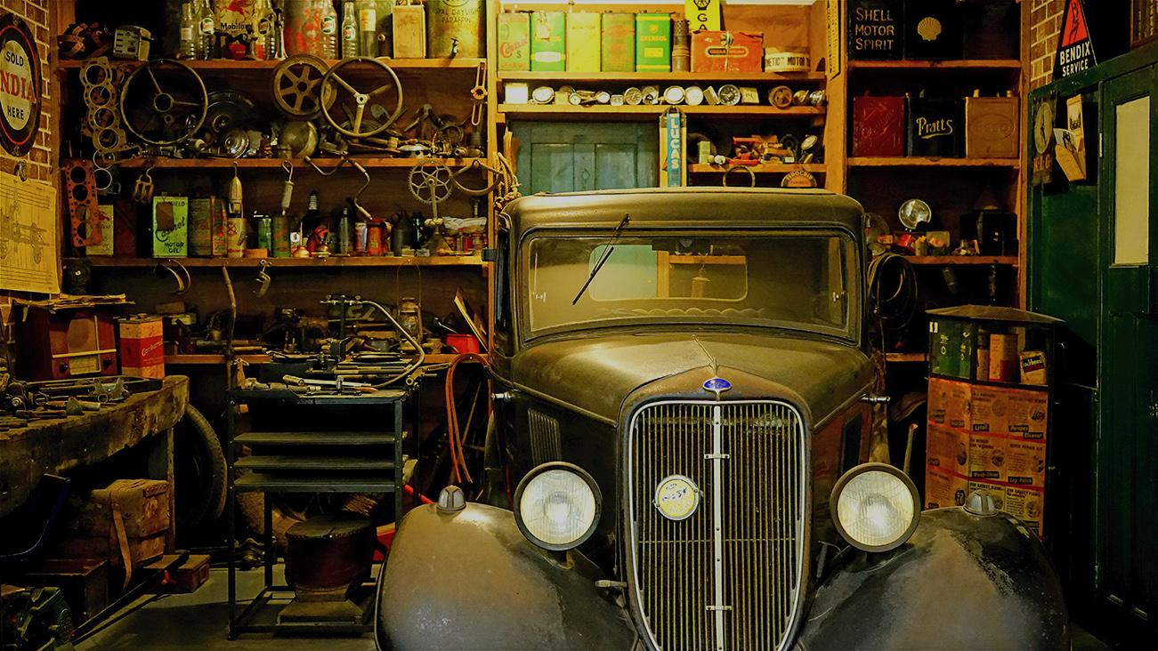
Literature review

Slide 6
S no. | Title | Purpose | Base Model | Methodology
1 | Diffsinger : Singing Voice Synthesis via Shallow Diffusion Mechanism | Singing Voice Synthesis | Shallow Diffusion Mechanism | High-quality singing voice generation using a shallow diffusion mechanism with a focus on capturing Chinese music nuances
2 | Melody-Conditioned Lyrics Generation with SeqGANs | Lyrics Gen. | Sequential GANs | End-to-end system with adversarial training, melody conditioning, and theme constraints
3 | Ai-Lyricist: Generating Music and Vocabulary Constrained Lyrics | Lyrics Gen. | SeqGAN-based system with multi-adversarial training | Music structure analysis, music–lyrics embedding, and vocabulary constraints
4 | UniLG : A Unified Structure-Aware Framework for Lyrics Generation | Lyrics Gen. | Unified Structure-Aware Framework (UniLG) | Leveraging a pre-trained Lyric-to-Beat model, considering lyrics structure, and accommodating various generation conditions
5 | Generating Topical Poetry with Formal Constraints | Poetry Gen. | RNN Language Model | Vocabulary selection, related word computation, rhyme word selection, FSA construction, and path extraction through RNN language model

Slide 7
S no. | Title | Purpose | Base Model | Methodology | Reference
6 | Hafez: An Interactive Poetry Generation System | Poetry Gen. | RNN-based poem generation | Related rhyme word search, FSA creation, and RNN-based poem generation | Ghazvininejad, M. et al. (2017)
7 | Lyrics Generation using LSTM and RNN | Lyrics Gen. | LSTM and RNN | Multilayer LSTM-based model with bidirectional neurons, incorporating BERT; training on lyrics of prominent musicians | Dhandapani, A. et al. (2022)
8 | Singing Voice Synthesis Based on Generative Adversarial Networks | Singing Voice Synthesis | Generative Adversarial Networks (GANs) | DNN-based singing voice synthesis, integrating GANs for refining speech parameters and addressing over-smoothing | Hono, Y. et al. (2019)
9 | Deep Learning in Musical Lyric Generation: An LSTM-Based Approach | Lyrics Gen. | LSTM | Word-level LSTM model, training on datasets from six genres, evaluating linguistic metrics using cosine similarity | Gill, H., Lee, D., & Marwell, N. (2020)

Slide 8
S no. | Title | Purpose | Base Model | Methodology
10 | Singing Voice Synthesis Using Deep Autoregressive Neural Networks for Acoustic Modeling | Singing Voice Synthesis | Deep Autoregressive Neural Networks (DAR) | DAR-based approach for enhancing singing voice synthesis, addressing challenges like vibratos and ensuring consistency with music notes
11 | SUSing: SU-net for Singing Voice Synthesis | Singing Voice Synthesis | SU-net architecture with a stripe pooling module | SU-net with convolution layers, stripe pooling, and deconvolution layers for enhancing singing voice synthesis
12 | MuseGAN: Multi-Track Sequential Generative Adversarial Networks for Symbolic Music Generation and Accompaniment | Music Gen. | Generative Adversarial Networks (GANs) | MuseGAN model for generating multi-track polyphonic music, exploring unconditional and conditional generation
13 | DeepRapper: Neural Rap Generation with Rhyme and Rhythm Modeling | Rap Lyrics Gen. | Transformer-based neural system | DEEPRapper for generating rap lyrics with rhyme and rhythm modeling, pre-training on non-rap lyrics, and lyrics without beats
14 | GhostWriter: Using an LSTM for Automatic Rap Lyric Generation | Rap Lyrics Gen. | LSTM Neural Network | GhostWriter for generating rap lyrics similar but not identical to a given artist's style, trained on an artist's lyrics with newline and verse end tokens

Slide 9
Data collection
William Shakespeare's Sonnet
This data is a text file consisting of 154 of the famous sonnets by William Shakespeare
Data link: William Shakespeare's Sonnet (kaggle.com)
Details and stats:
shakepeare.txt (41KB)
Total Number of Sonnets = 154
Sonnets Focused on Love = 126
Description of sonnets:
Romantic Love: Many sonnets address the beauty and love for a young man (the Fair Youth) and a mysterious woman (the Dark Lady).
Jealousy and Despair: Several sonnets express deep feelings of jealousy, betrayal, and despair.
Mortality and Time: A recurrent theme is the transient nature of life and beauty, with many sonnets contemplating the effects of time and the inevitable approach of death.
Poetic Immortality: Shakespeare often reflects on the power of his poetry to grant eternal life to his subjects through written word.

Slide 10
Methodology
Poetry output
display
Text generation Model
Generated text output
Voice synthesis
Input data
Output
Poetry by
renowned artist(.txt file)
Poetry
GAN
Instagram endeavours

Slide 11
Example
INPUT
From fairest creatures we desire increase,
That thereby beauty's rose might never die,
But as the riper should by time decease,
His tender heir might bear his memory:
But thou contracted to thine own bright eyes,
Feed'st thy light's flame with self-substantial fuel,
Making a famine where abundance lies,
Thy self thy foe, to thy sweet self too cruel:
Thou that art now the world's fresh ornament,
And only herald to the gaudy spring,
Within thine own bud buriest thy content,
And tender churl mak'st waste in niggarding:
Pity the world, or else this glutton be,
To eat the world's due, by the grave and thee.
When forty winters shall besiege thy brow,
And dig deep trenches in thy beauty's field,
Thy youth's proud livery so gazed on now,
Will be a tattered weed of small worth held:
Then being asked, where all thy beauty lies,
Where all the treasure of thy lusty days;
To say within thine own deep sunken eyes,
Were an all-eating shame, and thriftless praise.
How much more praise deserved thy beauty's use,
If thou couldst answer 'This fair child of mine
Shall sum my count, and make my old excuse'
Proving his beauty by succession thine.
This were to be new made when thou art old,
And see thy blood warm when thou feel'st it cold.
OUTPUT
From fairest creatures, beauty's rose,
In time, by tender heir, memory bestows.
Contracted to thine eyes so bright,
Self-fueled flame, a cruel self-fight.
Generational model

Slide 12
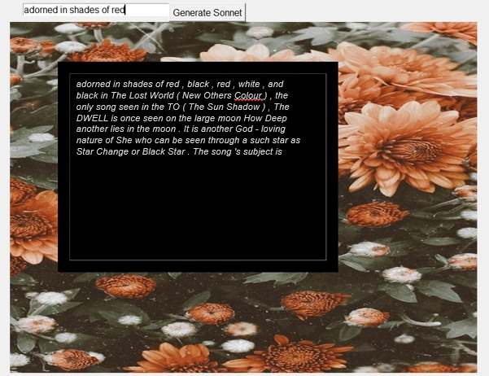
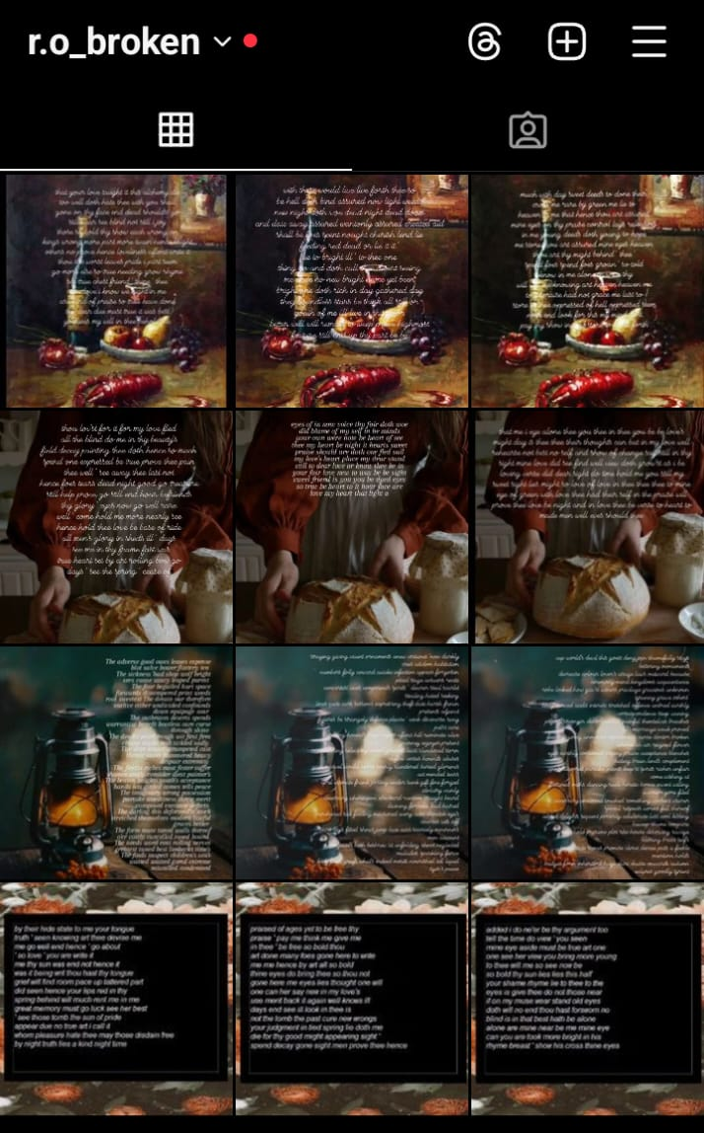
OUTPUT SCREENS

Slide 13
Results & Analysis

Slide 14
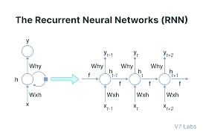
Sequential models
RNN (RECURRENT NEURAL NETWORKS)
hours that for thee is afford hate men men cupid
heat ' taken set counted me while you deeds still
brought his heart of state her shalt grow not and
skill away their woe outward brow windows windows so ill
cunning outward windows windows
…
Sequential Data Handling: RNNs remember previous inputs to understand the context.
Hidden States: RNNs use hidden states to pass information through the sequence.
Training Method: RNNs are trained using Backpropagation Through Time (BPTT).

Slide 15
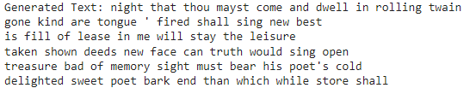
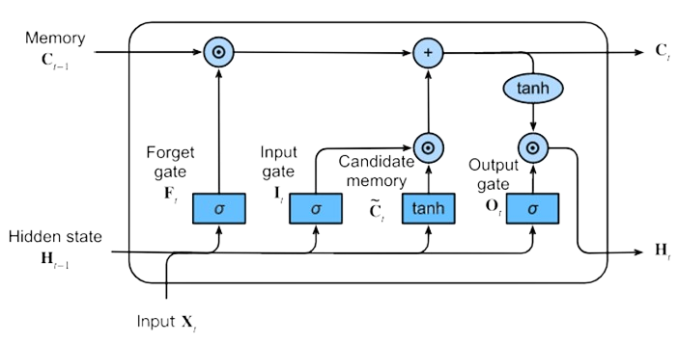
LSTM (LONG SHORT-TERM MEMORY)
Embedding Layer: Converts words into dense vectors to capture their meanings.
LSTM Layers: Process these vectors to understand the sequence.
Dropout Layer: Prevents overfitting by ignoring random inputs during training.
Dense Layer: Produces the next word in the sequence.

Slide 16
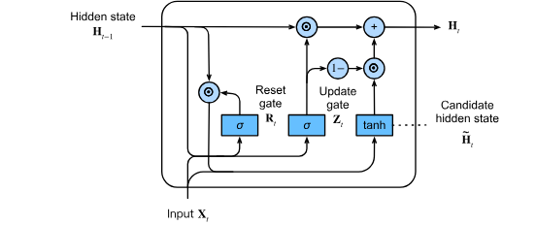
GRU (GATED RECURRENT UNITS)
Embedding Layer: Converts words into meaningful dense vectors.
GRU Layers: Process these vectors to understand the sequence.
Dropout Layer: Prevents overfitting during training.
Dense Layer: Produces the next word in the sequence.
beauteous and simple truth suppressed fired go days
' ' so give thine best you should
you are near slain see your blood were
crowned weep to thee that he die still
seem writ grace in thee shall then seen
me untrue see foes store there hour truth

Slide 17
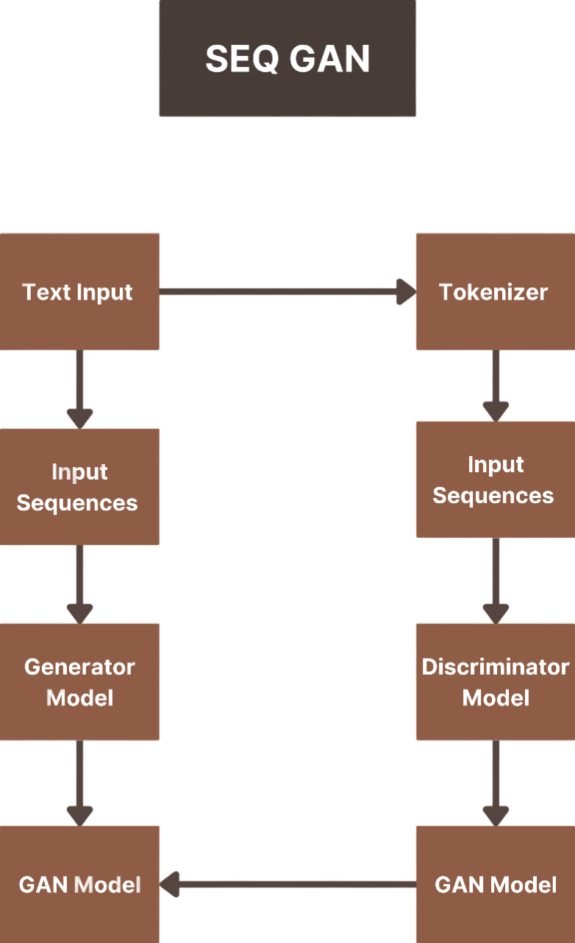
GANS (Generative adversarial networks)
SeqGAN (SEQUENTIAL GANS)
Adorned in shades of red send shake shake slide expressed teeth holds bevel fury directly garments' try hardest just just air hated hated plot
hope repent fiery homage infant's infant's guard guard guard tall tall twofold twofold wake wake wrecked wrecked beguile harsh answer
undivided presence cherubins sullied known known often but bier sickle's reckoning flown kills flown worthy injury offender's resting imprisoned livery sullen looked excess disgraced vice bitter bitter nothing nothing sunset bosom compile ere title fickle decay jade short ever ever hindmost substance substance loss loss watchman chips night sickle's mortality
SeqGAN Architecture:
Generator (RNN) creates sequences from seed text.
Discriminator evaluates real vs. generated sequences.
Training Process:
Pre-train Generator with MLE.
Adversarial Training with Discriminator feedback and Policy Gradient.
Application to Poetry Generation:
Generates poems from seed text.
Ensures poetic structure, consistency, and style.

Slide 18
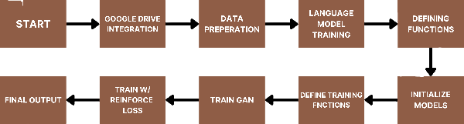
POETRY GAN
GAN Components:
Generator (G): Creates text sequences.
Discriminator (D): Evaluates real vs. generated text.
Training Process:
Prepares and loads text data.
Adversarial Training: Generator learns from Discriminator feedback.
Iteration and Improvement:
Generator improves poetry realism by reinforcement learning.
Discriminator enhances its detection of generated text.
adorned in shades of red , black , red , white , and black in The Lost World ( New Others Colour ) , the only song seen in the TO ( The Sun Shadow ) , The DWELL is once seen on the large moon How Deep another lies in the moon . It is another God - loving nature of She who can be seen through a such star as Star Change or Black Star . The song 's subject is

Slide 19
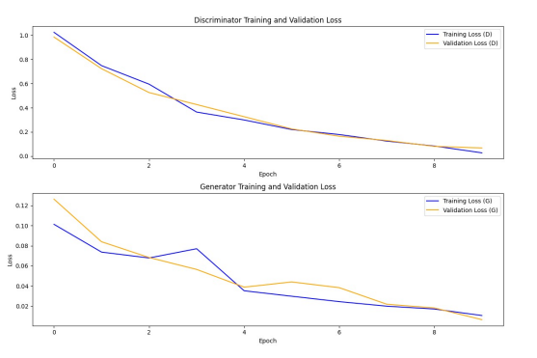
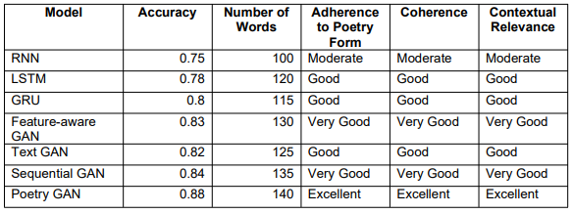
Performance by final model (POETRY GAN)
Metrics earned by the implemented models
Poetry GAN model training and validation graphs

Slide 20
Comparison study
Adorned in shades of red, the rose does bloom,
With petals soft that whisper to the dawn,
Its fragrance wafts through twilight's gentle gloom,
A beauty that no mortal hand has drawn.
Upon the lips of love, a tender hue,
In crimson blushes passion's silent vow,
The heart, enraptured by this fiery view,
Finds solace 'neath the scarlet-laden bough.
Yet fleeting is the flower's bright array,
For time, relentless, steals its colors true,
In autumn's breath, it fades from light of day,
A memory of summer's vibrant hue.
Thus life itself in shades of red is cast,
A fleeting flame that burns, but cannot last.
Perfect shakespearean sonnet format
Iambic pentameter adherence
Coherent sonnet generation
Emotional content generation
Adherence to seed text
Perfect grammar and structure

Slide 21
Conclusion
The models RNNs, LSTMs, and GRUs from the deep learning model family, as well as SeqGANs and PoetryGAN from the family of GANs, were employed and studied for poetry generation purposes, and compared with the performance of ChatGPT-4 on sonnet generation.
From our comparison study, it could be concluded that the excellent performance by ChatGPT could be attributed to the fact that it’s a large language model, trained on massive amounts of data, with reinforcement learning based on human feedback pushing it to perfection.
Hence, if models are built and trained on large amounts of text and information, they can one day catch up to match cgpt's the sonnet generation prowess.

Slide 22
Limitations & Recommendations
As discussed, certain issues were faced with Iambic pentameter adherence, coherence, and following perfect grammar and structure when generating sonnets.
Apart from just these three algorithms, there are other notable text generation algorithms and architectures that haven’t yet been tried, but could easily be built on and incorporated in systems constructed for this purpose:
In the family of deep learning models, higher-order Markov models, can capture the probabilistic relationships between words and generate text based on learned transitions.
Variational Autoencoders (VAEs) can be used for generating di-verse and creative text by sampling from the learned latent space.
Models like the Hierar-chical Recurrent Encoder-Decoder (HRED) can be used for generating structured and hi-erarchical text, which could be beneficial for certain types of poetry.
Transformer architectures, a class of deep architecture models, are effective for text generation, and models like GPT-3, GPT-2, Transformer-XL, XLNet, and T5 can be adapted for creative writing tasks as well.

Slide 23
Thank You!
SHAMITHA JAJULA 160620747018
SIDRA AZEEM 160620747044
SRAVANTHI LAKSHMI GUNAMPALLI 160620747046
Under the Guidance of Ms. SUMERA, Assistant Professor at Stanley College of Engineering and Technology for Women

